Slide 1
JAVA PROJECT
CSE-310
Presented to : Dr.A.Ranjith Kumar

Slide 2
MEMORY MATCH MANIA-
A FUN AND CHALLENGING BRAIN EXERCISE

Slide 3
Introduction
Scope of the Project
Points
CONTENTS
Modules
Conclusion

Slide 4
Introduction
Pair matching game is a popular and entertaining puzzle game that challenges the player's memory skills. The game involves flipping over pairs of cards to reveal hidden images, with the objective of finding all matching pairs.

Slide 5
SCOPE OF THE PROJECT
A game board consisting of a grid of cards with hidden images.
2.The ability to restart the game and reshuffle the cards.
3.The ability to reveal the hidden image by clicking on them.

Slide 6
4.The ability to detect matching pairs and remove them from the game board.
5.The game will have multiple levels of difficulty, with different grid sizes and numbers of card pairs

Slide 7
POINTS
The project handles user input and event handling using Swing's ActionListener interface, which allows it to respond to user actions such as button clicks and mouse events.
The game's difficulty level is chosen by the user at the start of the game using a separate JFrame that offers two options: easy and hard..

Slide 8
Different levels of difficulty.
A timer which keeps track of the time spent in the game.
The ability to restart the game and reshuffle the cards.
The game uses a simple algorithm to shuffle the cards and distribute them randomly on the game board.
The ability to detect matching pairs and remove them from the game board.

Slide 9
A login page which will only redirect us to the GUI if the entered username and password is correct.
An exit button which will terminate the game when pressed.
Different pop up messages and various frames which allows the user to play the game again.
The game terminates after the time finishes.

Slide 10
MODULES
MAIN CLASS | LOGIN
DIFFICULTY WINDOW | GAME

Slide 11
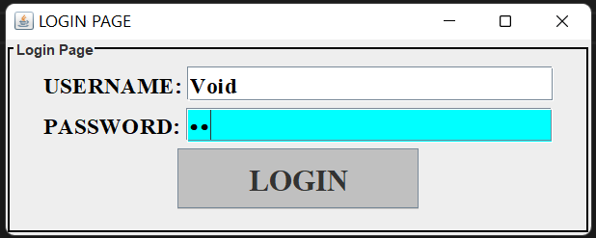
LOGIN
This is a simple login page using Java. It creates a JFrame with a JPanel inside that contains a JLabel for the username, a JTextField for the user to enter their username, a JLabel for the password, a JPasswordField for the user to enter their password, and a JButton for the user to click to login.

Slide 12
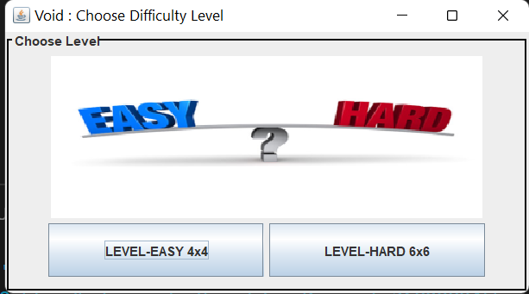
DIFFICULTY WINDOW
In this module JPanel is used to create a panel that contains two JButton components that represent the easy and hard levels of the game, respectively

Slide 13
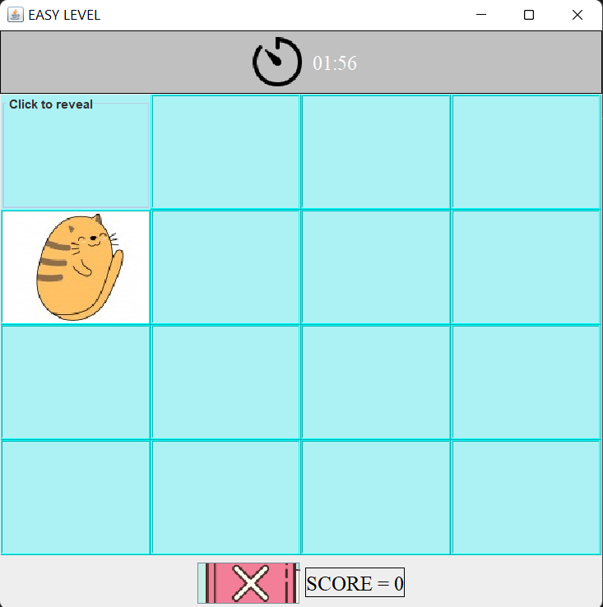
GAME
The game has two levels, "EASY" and "HARD", which correspond to grid sizes of 4x4 and 6x6 respectively. The game also has a timer that starts when the player clicks on the fisrt button and counts down from 2 minutes.The player can choose to exit the game at any time, and a score is displayed when the game is closed.

Slide 14
CONCLUSION
In conclusion, the matching game is a simple yet interesting game that was implemented in Java using basic GUI components. The objective of the game was to match pairs of images hidden behind buttons by flipping them over in pairs until all pairs are found.Overall, this game was a good exercise for me to practice my programming skills and improve my problem-solving abilities.

